Slide 1
ReactJS
about new

Slide 2
Recap
ReactJS is a micro library for UI rendering
ReactJS uses VirtualDOM to update the DOM that is why it's fast
ReactJS applications are made up of components

Slide 3
Recap
Components are made up of elements
There are 2 types of components Smart vs Dumb
You can define components via class or by a function
Its up to you how you compose your app

Slide 4
Recap
Components are made using JSX
JSX is javascript + html
JSX is closer to javascript than to html

Slide 5
Props, State and Lifecycle
about new

Slide 6
Props
Short term for properties
Data received by components
Can be accessed by components defined by class and function
Props are read only (never mutate or change your props) – this means they are immutable
Notes:
Demo how to pass props to both dumb and smart
Demo 3 levels smart -> smart -> dumb
function Welcome(props) { return <h1>Hello, {props.name}</h1>; } const element = <Welcome name="Sara" />;

Slide 7
Props
Short term for properties
Data received by components
Can be accessed by components defined by class and function
Props are read only (never mutate or change your props) – this means they are immutable
Notes:
Demo how to pass props to both dumb and smart
Demo 3 levels smart -> smart -> dumb
function Welcome(props) { return <h1>Hello, {props.name}</h1>; } const element = <Welcome name="Sara" />;

Slide 8
Demo
Demo how to pass props to both dumb and smart
Demo 3 levels smart -> smart -> dumb
Pass functions (alert) as props
Notes:
Demo how to pass props to both dumb and smart
Demo 3 levels smart -> smart -> dumb
function Welcome(props) { return <h1>Hello, {props.name}</h1>; } const element = <Welcome name="Sara" />;

Slide 9
State
Has a default value when a component is mounted
Can be mutated or changed over time because of user actions, server response, etc.
Components manage its own state internally
It should not meddle with the state of its child components
State is private or is owned and managed by the component

Slide 10
State
Do not modify the state directly. Use the built in method setState()
Be careful since the updating the state is asynchronous
Notes:
Demo state on and off
Create multiple On and off inside App.js

Slide 11
Demo
Demo state on and off
Create multiple On and off inside App.js
Conditional rendering if else

Slide 12
Props vs State
Smart Components
Can have props and state
Dumb Components
Can only have props

Slide 13
Good resources to read:
https://github.com/uberVU/react-guide/blob/master/props-vs-state.md
https://lucybain.com/blog/2016/react-state-vs-pros/

Slide 14
Demo Timer with Delay

Slide 15
Component Life Cycle
Each component has several lifecycle methods that you can override to run code at particular times in the process.

Slide 16
Component Life Cycle
Each component has several lifecycle methods that you can override to run code at particular times in the process.

Slide 17
Mounting
These methods are called in the following order when an instance of a component is being created and inserted into the DOM:
constructor()
static getDerivedStateFromProps()
render()
componentDidMount()

Slide 18
Updating
An update can be caused by changes to props or state. These methods are called in the following order when a component is being re-rendered:
static getDerivedStateFromProps()
shouldComponentUpdate()
render()
getSnapshotBeforeUpdate()
componentDidUpdate()

Slide 19
Unmounting
This method is called when a component is being removed from the DOM:
componentWillUnmount()

Slide 20
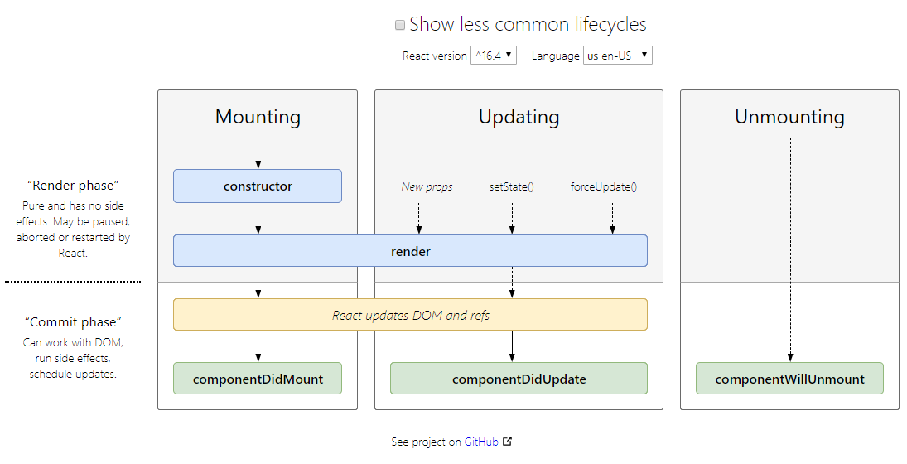
Component Life Cycle

Slide 21
Demo life cycles (alert)

Slide 22
render()
Only required for class components
Do not change the state here (it will cause an endless loop)
Note: render() will not be invoked if shouldComponentUpdate() returns false.

Slide 23
constructor()
Note: If you don’t initialize state and you don’t bind methods, you don’t need to implement a constructor for your React component.
Demo state initialization and binding of methods
You should not call setState() in the constructor().

Slide 24
componentDidMount()
Is invoked immediately after a component is mounted (inserted into the tree).
Initialization that requires DOM nodes should go here.
If you need to load data from a remote endpoint, this is a good place to instantiate the network request.
You may call setState() immediately in componentDidMount().

Slide 25
componentDidUpdate()
Is invoked immediately after updating occurs.
This method is not called for the initial render.
You may call setState() immediately in componentDidUpdate() but note that it must be wrapped in a condition. If not, it will cause an endless loop.
Note: componentDidUpdate() will not be invoked if shouldComponentUpdate() returns false.

Slide 26
componentWillUnmount()
Is invoked immediately before a component is unmounted and destroyed.
Perform any necessary cleanup in this method, such as invalidating timers, canceling network requests, or cleaning up any subscriptions that were created in componentDidMount()

Slide 27
componentWillUnmount()
You should not call setState() in componentWillUnmount() because the component will never be re-rendered. Once a component instance is unmounted, it will never be mounted again.

Slide 28
forceUpdate()
By default, when your component’s state or props change, your component will re-render.
If your render() method depends on some other data, you can tell React that the component needs re-rendering by calling forceUpdate().
Demo forceUpdate

Slide 29
Summary
Props is read only and is received by component
State can be mutated and is managed by the smart component
Data flow is one way only
Components have different life cycle methods that can be overridden
You can force a component to render using forceUpdate()

Slide 30
Handling Events
about new

Slide 31
Event Handling
Handling events with React elements is very similar to handling events on DOM elements. There are some syntactic differences:
React events are named using camelCase, rather than lowercase.
With JSX you pass a function as the event handler, rather than a string.

Slide 32
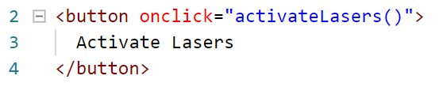
Traditional HTML

Slide 33

ReactJS

Slide 34
HTML vs ReactJS
Another difference is that you cannot return false to prevent default behavior in React. You must call preventDefault explicitly. For example, with plain HTML, to prevent the default link behavior of opening a new page, you can write:

Slide 35
Traditional HTML

Slide 36
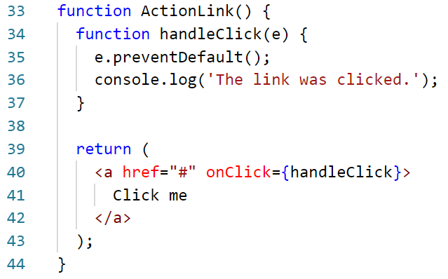
ReactJS

Slide 37
ReactJS Event Handling
When using React you should generally not need to call addEventListener to add listeners to a DOM element after it is created. Instead, just provide a listener when the element is initially rendered.
When you define a component using an ES6 class, a common pattern is for an event handler to be a method on the class. See example on and off component

Slide 38
Passing Arguments to Event Handlers
Inside a loop it is common to want to pass an extra parameter to an event handler. For example, if id is the row ID, either of the following would work:

Slide 39
Rendering Multiple Components
Use javascript method map in arrays to iterate and return components/elements as lists.
Demo timer from array of delays

Slide 40
Forms
about new

Slide 41
Demo:
<input/>
<textarea/>
<select/>

Slide 42
Activity 3:
Create a form with at least 5 fields (input, checkbox, radio, textarea, select) + 1 image input
Create another part where the changes of the form would be seen (it should update in real time)
Create a timer at the top of the page

Slide 43
